Slide 1
Introduction to Machine Learning: Naïve Bayes, Linear and Logistic Regression
Amos Azaria

Slide 2
Databases and Machine Learning
So far we have dealt with retrieving data that was previously stored.
Many times we want to retrieve missing data, that is, data that we do not have. What if we want to know what will happen on new, unobserved data?
For example, suppose some of our users are tagged as employed or unemployed, and our system needs to decide whether to show an ad which is relevant only to unemployed users.

Slide 3
Machine Learning (cont.)
Assume we are given a training set (e.g. data on people and an indicator whether they are employed or not), and then we are given a new example (e.g. a new person), and we want to predict a value (e.g. employment).
?
experience
age
Notes:
GPA = Grade Point Average

Slide 4
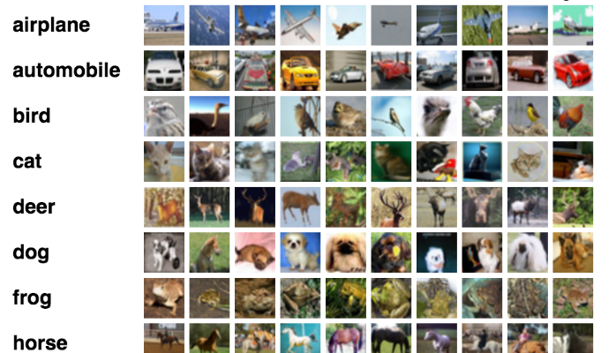

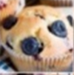



Slide 5
Video…
https://www.youtube.com/watch?v=1eBxt9HUfh8

Slide 6
Machine Learning definition
“A computer program is said to learn from experience E with respect to some class of tasks T and performance measure P, if its performance at tasks in T, as measured by P, improves with experience E.” (Tom Mitchell)

Slide 7
Building a Machine Learning Classifier
To solve the employment problem (or similar problems), we build a machine learning model (called a classifier) that, when given a new instance (a user), predicts a label (whether she is employed or not).
There are many machine learning classification algorithms:
Naïve Bayes
Logistic regression
Neural networks
SVM
Decision Trees
KNN

Slide 8
Train / Test Split
In order to train our classifier, we must have some labeled data (for example, we must know for some users whether they are employed or not).
In order to evaluate the performance of our classifier, we split our data into train and test sets, train our classifier on the train set, and then test it on the test set.

Slide 9
Naïve Bayes
Amos Azaria

Slide 10
Naïve Bayes
Naïve Bayes is a generative classifier that is based on the Bayes Rule.
Naïve Bayes considers only the dependency of the features on the category (that is why it is called Naïve).
Naïve Bayes can work also with missing features.

Slide 11
Spam Classifier
Spam:
Buy it, pay later! Click me!
You Won 10000 Dollars! Click here!
Real (Non-Spam):
Will See you later.
Will you want to meet later?
I'm waiting for you.
Test:
- Are you paying too much? Click now!

Slide 12
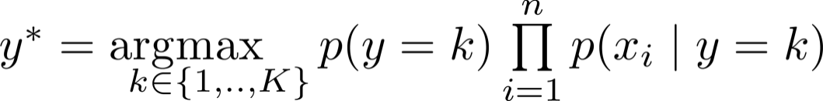
Counting Messages / Documents
If we perform stemming (or lemmatization): paying=pay
 | Examples | are | you | paying | too | much | ? | click | now | !
Spam | 2 | 0 | 1 | 1 | 0 | 0 | 0 | 2 | 0 | 2
Real | 3 | 0 | 3 | 0 | 0 | 0 | 1 | 0 | 0 | 0
 | Examples | are | you | paying | too | much | ? | click | now | !
Spam | 3 | 1 | 2 | 2 | 1 | 1 | 1 | 3 | 1 | 3
Real | 4 | 1 | 4 | 1 | 1 | 1 | 2 | 1 | 1 | 1
Spam:
Buy it, pay later! Click me!
You Won 10000 Dollars! Click here!
Real (Non-Spam):
Will See you later.
Will you want to meet later?
I'm waiting for you.
Test:
- Are you paying too much? Click now!
Laplace's Smoothing (rule of succession)
For smoothing, we may take into account the vocabulary length and length of every message.
In practice, we many times maximize the log (so we don't need to deal with such small numbers).
Note that when using the log, we sum rather than multiply.
We assume that there is a message that includes the word and one that doesn't

Slide 13
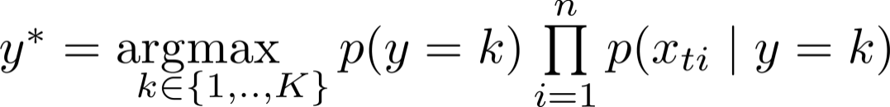
Counting Words Multiple Times
 | Examples | Total words | are | you | paying | too | much | ? | click | now | !
Spam | 2 | 17 | 0 | 1 | 1 | 0 | 0 | 0 | 2 | 0 | 4
Real | 3 | 18 | 0 | 3 | 0 | 0 | 0 | 1 | 0 | 0 | 0
 | Examples | Total words | are | you | paying | too | much | ? | click | now | !
Spam | 3 | 17+28 | 1 | 2 | 2 | 1 | 1 | 1 | 3 | 1 | 5
Real | 4 | 18+28 | 1 | 4 | 1 | 1 | 1 | 2 | 1 | 1 | 1
Laplace's Smoothing (rule of succession)
The first option (of counting messages) is the one we will be dealing with now.

Slide 14
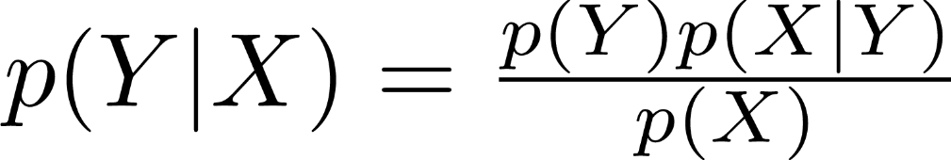
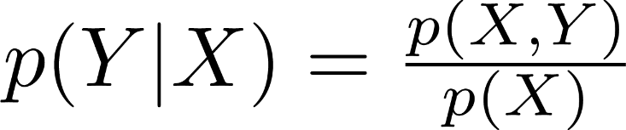
Bayes Rule
$$p\left(Z=z∈X, Z=z∈Y\right)=p\left(Z=z∈X \right)p\left(Z=z∈Y\right|Z=z∈X)$$
X
Y
This is an important formula which is always true!

Slide 15


Naïve Bayes (Why? How?)
Notation:
The instances (messages in our case) are denoted by:
m in our case is 5
(so x₁= Buy it, pay later! Click me!)
Note that each of the xs is a vector:
The classes (Spam/Real in our case) are denoted by:
(so y₁=spam)

Slide 16
Naïve Bayes (Cont.)
Suppose we have a new message x_{t} (a vector) and we want to find the most likely class (y), that is, we want to know if x_{t} is more likely to present class 0 (e.g. Spam) or class 1 (not-spam), etc.
For that we want to compute for every k: p(y=k|x_{t})
We then pick the k that maximizes the above.
Denote that k as y*.

Slide 17
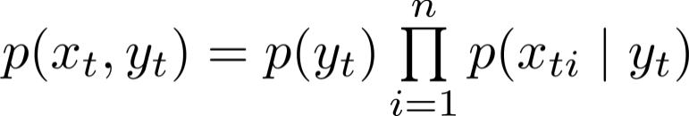
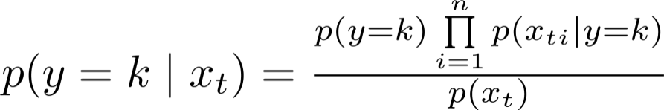
Naïve Bayes
Naïve Bayes makes the conditionally independent assumption:
Always true
Naïve Bayes assumption
Bayes Rule
Independent of K (so we can ignore when looking for the maximum)

Slide 18

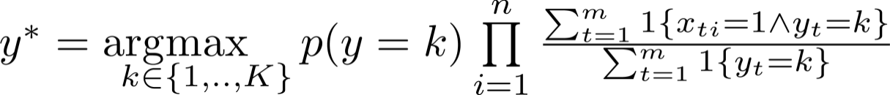
Naïve Bayes (Cont.)
Note that the calculations shown previously (the fractions of the appearances of every word) aren't an immediate corollary of the formula we derived.
In general we try to maximize the likelihood of the data:
It turns out (and easy to show), that if we use the fraction of messages each word appears in (as we have done), we in-fact maximize the likelihood of the data.
We end up with:
Notes:
(Just as it is easy to show it in a Bernoulli case).
x_{ti}=1 means that in the vector representation, the word i is present in x_t.

Slide 19
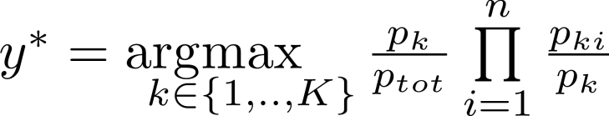
Multiple predictions
How would we prepare the data for multiple queries?
Determine how many documents we have in total. Denote this value by p_{tot .}
We first count how many documents every class has. Denote these values by: p_{k .}
[We then find all words that appear in all documents and form a dictionary.]
For each word in the dictionary (i) and for every class (k), we need to count how many documents it appears in. Denote these values by p_{ki .}
For every new query we simply compute:

Slide 20
Online Naïve Bayes: Parallel Execution (In Spark)
Suppose the data is stored in an RDD as (message, class) tuples. E.g. (greeting / valediction):
input_data = sc.parallelize([("hello there", 0), ("hi there", 0), ("go home", 1), ("see you",1), ("good bye to you", 1)])
We need to find p_{tot}, p_{k} and all p_{ki}:
>>> pk = input_data.map(lambda (message, cls): (cls, 1)).reduceByKey(lambda a,b: a+b).collectAsMap()
>>> ptot = sum(pk.values())
>>> pki = input_data \
.flatMap(lambda (message, cls): list(set([(cls,w) for w in message.split()]))) \
.map(lambda (cls, word): ((cls,word), 1)) \
.reduceByKey(lambda a,b: a+b).collectAsMap()
Notes:
Valediction = farewell, closing

Slide 21
Answering a new query
>>> import numpy as np
>>> query = "hello hi"
>>> class_probs = [pk[k]/float(ptot)*np.prod (np.array([pki.get((k,i),0)/float(pk[k]) for i in query.split()])) for k in range(0,2)]
>>> print(class_probs)
[0.10000000000000001, 0.0]
>>> y_star = np.argmax(np.array(class_probs))
>>> print(y_star)
0
Cast not required in Python 3
0 as default
No Laplass smoothing, so we get zeros.
It is indeed a greeting!

Slide 22
What is a good classifier?
Accuracy?
What if we classify cancer with a 1% chance?
If we classify all as healthy, we will have 99% accuracy.
What would you think about a classifier that:
catches 98% of the cancers,
but has only 30% precision (if you are told that you might have cancer, there is only 30% that you actually have).
Notes:
You can have additional tests.

Slide 23
Recall and Precision
Confusion Matrix | Classified as Positive | Classified as Negative
Really Positive | True Positive | False Negative
Really Negative | False Positive | True Negative
Accuracy?
Trues / All
(True Positive + True Negative) / (True Positive + True Negative + False Negative + False Positive)
Recall
What fraction of positives did we actually find?
True Positive / Really Positive
True Positive / (True Positive + False Negative)
Precision:
If we say positive, how precise are we?
True Positive / Classified as Positive
True Positive / (True Positive + False Positive)

Slide 24
F-Measure (F₁-Score, F-Score)
A combination of precision and recall:
2 (Precision * Recall) / (Precision + Recall)
E.g.:
Precision = 1, recall = 0,
F-Measure = 0
Precision = recall = 0.5
F-Measure = 0.5
Precision = recall = x
F-Measure = x

